Slide 1

“IntelligentAcademicPerformance
Experiential Learning Project Assessment-II
on
Tracker & Visualizer”
under the course
Python Programming Language (N-PCCCM304P)
Presented By: Diggaj Turkar [CM25076]
Under the Guidance of
Mrs. Mayuri Getme
Session: 2026-27 (ODD)
Department of CSE(AI&ML)
S. B. JAIN INSTITUTE OF TECHNOLOGY MANAGEMENT AND RESEARCH, NAGPUR
An Autonomous Institute, Affiliated to RTMNU, Nagpur

Slide 2
Contents
Problem statement Objectives Algorithm
Flowchart / pseudocode Understanding of Python logic Graphical representation and working
GitHub account, repository creation, uploading code, meaningful commits, collaboration, individual contribution
Result / expected output
S. B. Jain Institute of Technology Management and research

Slide 3
1. Problem Statement
Students receive marks and attendance data from multiple subjects, but manually calculating grades, GPA/CGPA, attendance percentage, and performance trends can be time-consuming and error-prone.
The application should accept student academic data, calculate subject-wise grades and overall GPA/CGPA, check attendance, and present results through clear charts and graphs.
The system aims to provide a simple Python-based academic dashboard that helps students understand strengths, weak subjects, attendance status, and progress across semesters.

Slide 4
2. Objective
To develop a Python application for tracking student academic performance.
To calculate subject-wise marks, grades, grade points, and attendance percentage.
To calculate semester GPA and overall CGPA from academic records.
To identify strong and weak subjects using score comparisons. To visualize marks and performance trends using charts and graphs.
To provide a simple and understandable academic performance summary.
To practice Python data handling, functions, calculations, and visualization.

Slide 5
3. Algorithm
Start the program.
Enter student details and subject-wise marks, credits, and attendance.
Calculate total/percentage and attendance percentage for each subject.
Convert marks into grades and grade points using the grading scale.
Calculate weighted semester GPA using grade points and subject credits.
Calculate CGPA from semester GPAs or cumulative credit-weighted points.
Generate subject-wise and semester-wise charts for visualization.
Display the academic summary, attendance status, grades, GPA/CGPA, and trends.
Stop the program.

Slide 6




















4. Flowchart
Start
Enter student data
Calculate marks & attendance
Assign grades & grade points |  | Calculate GPA / CGPA
Generate charts & trends
Display performance summary
End

Slide 7
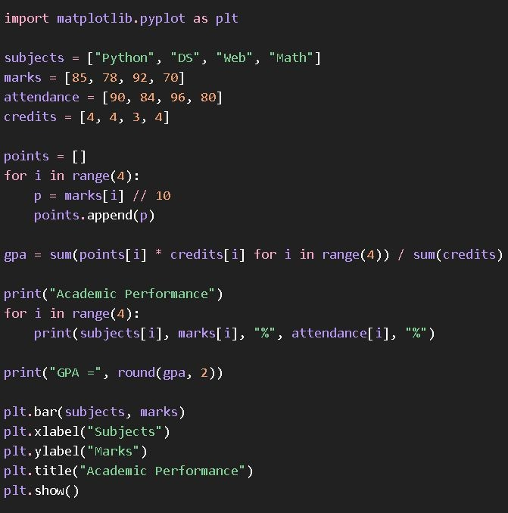
5. Understanding of Python Logic

Slide 8
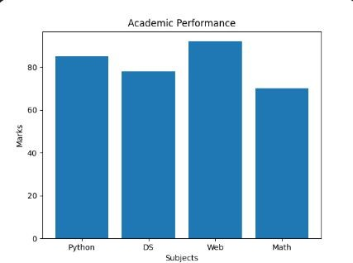
6. Graphical Representation and Working
Working: Input → validation → grade calculation → GPA/CGPA calculation → attendance analysis → chart generation
→ final academic dashboard.
Illustrative values demonstrate the intended visualization.

Slide 9
7. GitHub Account, Repository & Collaboration
Create GitHub Account – Set up a personal GitHub account. Create Repository – Intelligent Academic Performance Tracker & Visualizer.
Upload Code – Upload the Python source code, requirements, and README.
Meaningful Commits – Save changes with clear messages such as “Added GPA calculation” or “Added charts”.
Collaboration – For teamwork, use repository sharing, branches, or pull requests.
Individual Contribution – Each member contributes and commits their work.
Track Changes – Use GitHub to manage versions, issues, and project updates.

Slide 10
8. Individual Contribution
Problem Analysis – Identified the need for an automated academic performance tracker.
Data Design – Planned the structure for subjects, marks, credits, attendance, and semesters.
Python Coding – Implemented input handling, grading logic, GPA/CGPA calculations, and validation.
Visualization – Created subject-wise performance and semester trend charts.
Testing – Tested calculations using different marks, credits, and attendance values.
GitHub Contribution – Uploaded code and made meaningful commits.
Documentation & PPT – Prepared project documentation and presentation slides.

Slide 11
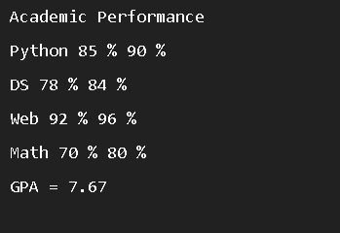
9. Result / Expected Output

Slide 12
1. Phase 2
Phase 1 recap
Problem: manually calculating grades, GPA/CGPA and attendance is slow and error-prone.
Objective: a Python application that calculates results and visualizes academic performance.
Phase 1 completed: problem statement, algorithm, flowchart, Python logic, sample chart and GitHub repository.
Phase 2 focus: working modules, code implementation, visualization output and GitHub collaboration.

Slide 13
2. Project Progress (Work Done ~70%)
Module | Work Done | Status
Input & Validation | Student, marks, credits and attendance entry with range checks | Completed
Grade & GPA Engine | Grades, grade points, semester GPA and CGPA | Completed
Attendance Analysis | Attendance % and eligibility status per subject | Completed
Visualization | Subject-wise bar chart and semester GPA trend | Completed
Data Storage | Saving and loading academic records in CSV files | In Progress
Summary Report | Final dashboard and report export | Pending

Slide 14
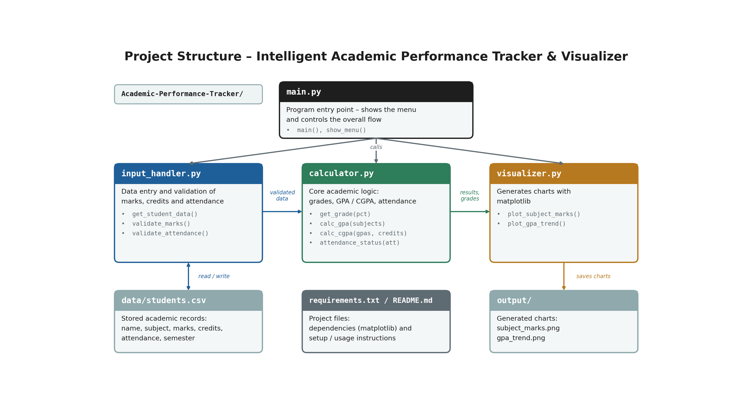
3. Project Structure
Modular design: each file has one responsibility, which makes testing and collaboration easier.

Slide 15
4. Testing, Challenges & Next Steps
Testing done so far
GPA/CGPA checked against manual calculations with different marks and credits.
Invalid inputs (negative marks, attendance above 100) handled by validation.
Challenges faced
Handling different credit values while computing weighted GPA and CGPA.
Phase 3 plan
Finish CSV storage and report export, complete final testing and deploy the project.

Slide 16
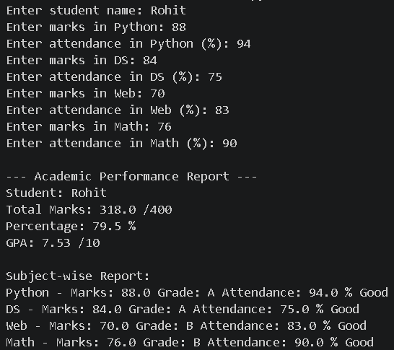
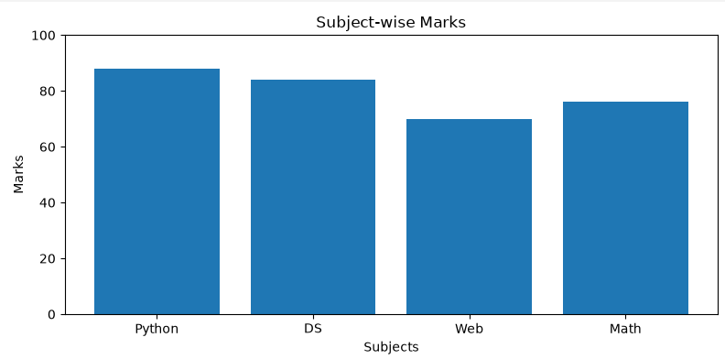
5. Input data & Graphical Representation:

Slide 17
1. Phase 3 – Final Implementation
Phase 3 Goal: Complete the academic performance tracker with reliable calculations, data storage, final reporting, and deployment.
Completed: student and subject inputs, validation, grades, grade points, GPA/CGPA, attendance eligibility, and performance charts.
Final improvements: save and load records using prepare a clear academic summary.
Final stage: run end-to-end tests, fix errors, and prepare the project for demonstration.

Slide 18
2. Project Progress (Target: 100%)
Module | Final Work | Status
Input & Validation | Student details and range checks | Completed
Grade & GPA Engine | Grades, grade points, GPA and CGPA | Completed
Attendance Analysis | Attendance percentage and eligibility | Completed
Visualization | Marks and GPA performance charts | Completed
Data Storage | Save and load records using CSV files | Completed
Summary Report | Final academic summary and report output | Completed

Slide 19
3. Final Testing & Deployment
Final testing completed
Checked grade, percentage, GPA/CGPA, and attendance calculations with sample records.
Tested invalid marks, negative values, and attendance outside the 0–100 range.
Verified that charts and the academic summary display the entered data.
Data handling
CSV storage supports saving and loading student records for later use.
Deployment plan
Upload the project code and requirements to GitHub, then deploy the web version using Streamlit Community Cloud.

Slide 20
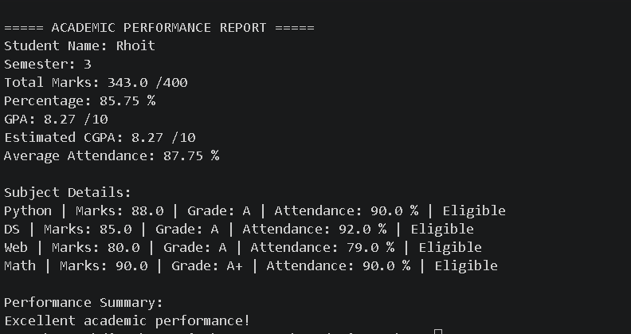
4. Input details

Slide 21
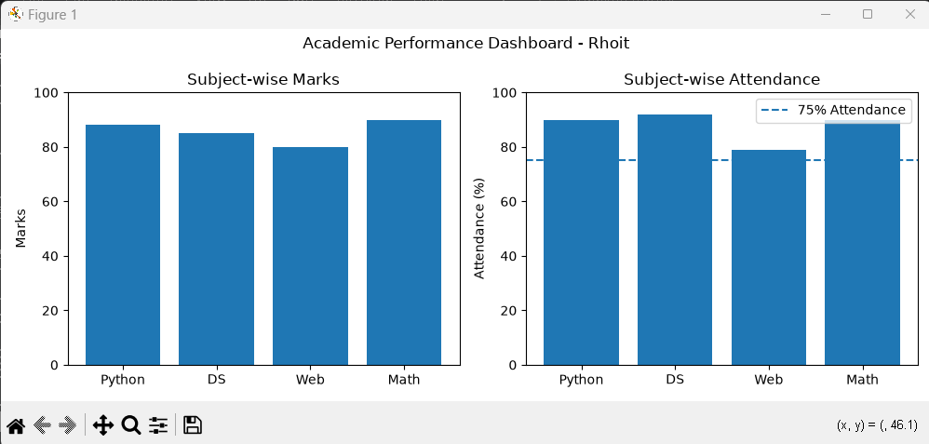
5. Graphical Representation

Slide 22
6. Final Result & Conclusion
Final Result:
Developed the final version of the Intelligent Academic Performance Tracker & Visualizer.
Implemented student data validation, grade calculation, GPA/CGPA calculation, and attendance analysis.
Generated graphical representations to compare subject-wise marks and academic performance trends.
Conclusion :
The project aims to simplify academic performance tracking by automating grade calculations, GPA/CGPA analysis, and attendance monitoring. Graphical visualization helps students identify their strengths and weaknesses. Phase 3 focuses on final testing, data storage, report generation, and deployment to make the application more reliable and user-friendly.

Slide 23
Thank You
Intelligent Academic Performance Tracker & Visualizer

